Slide 1


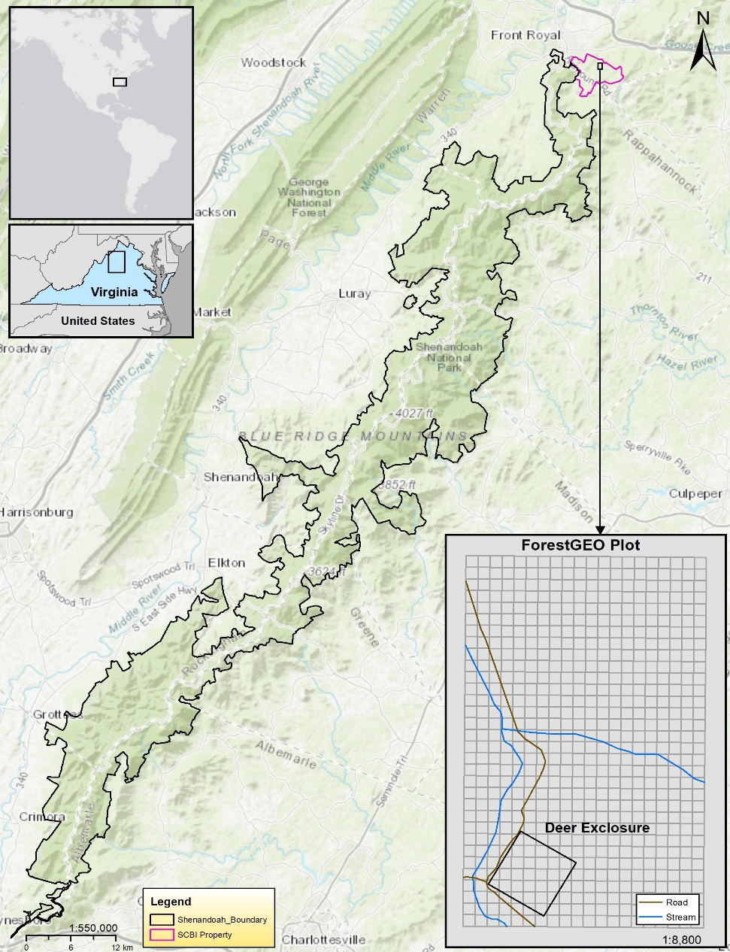
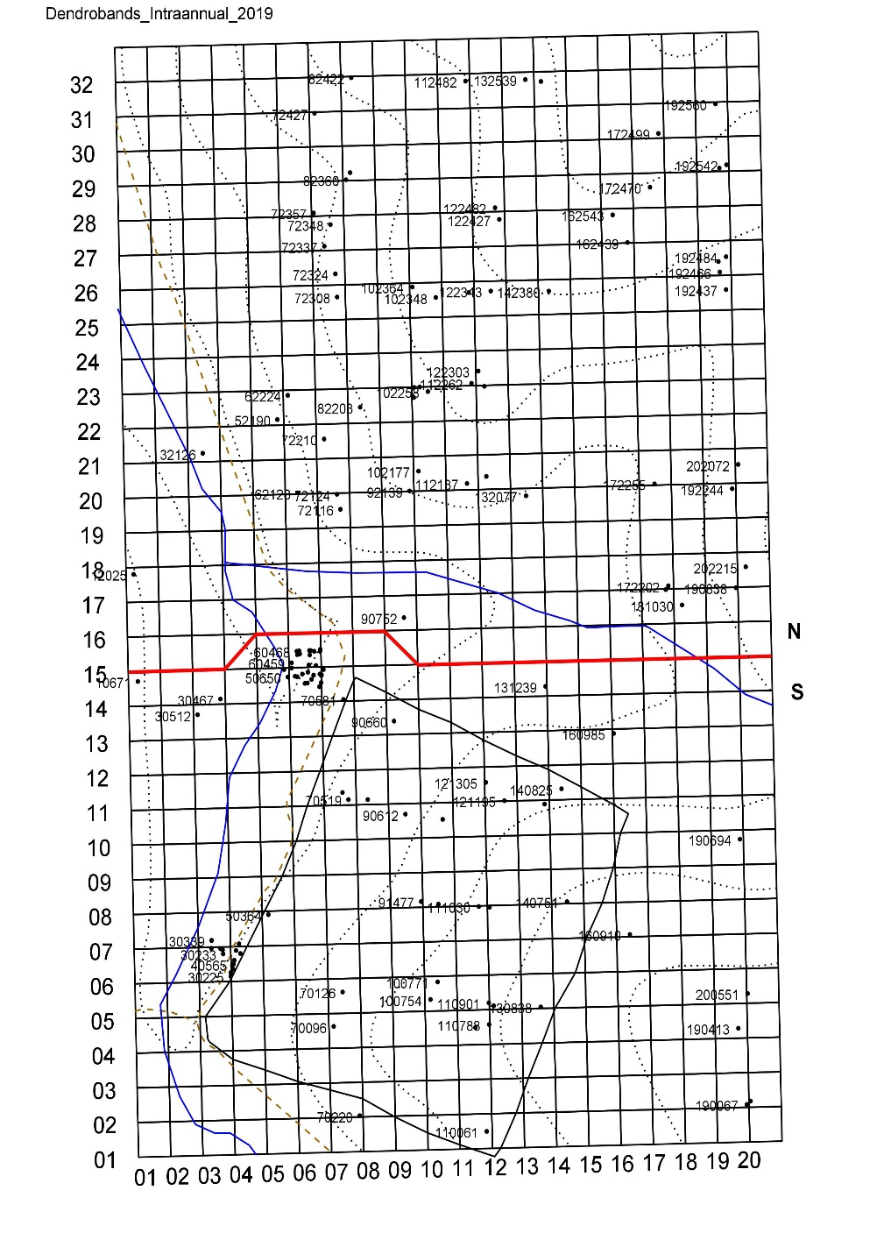
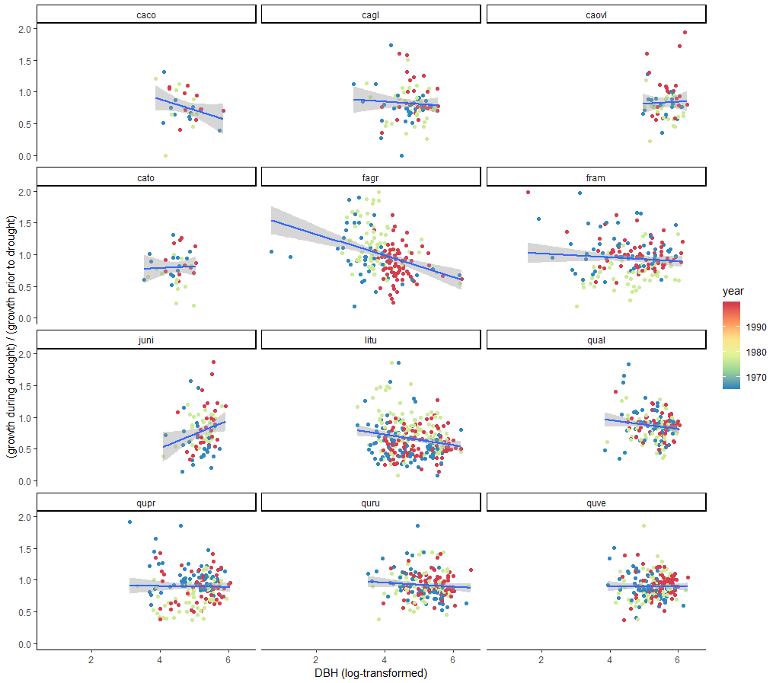
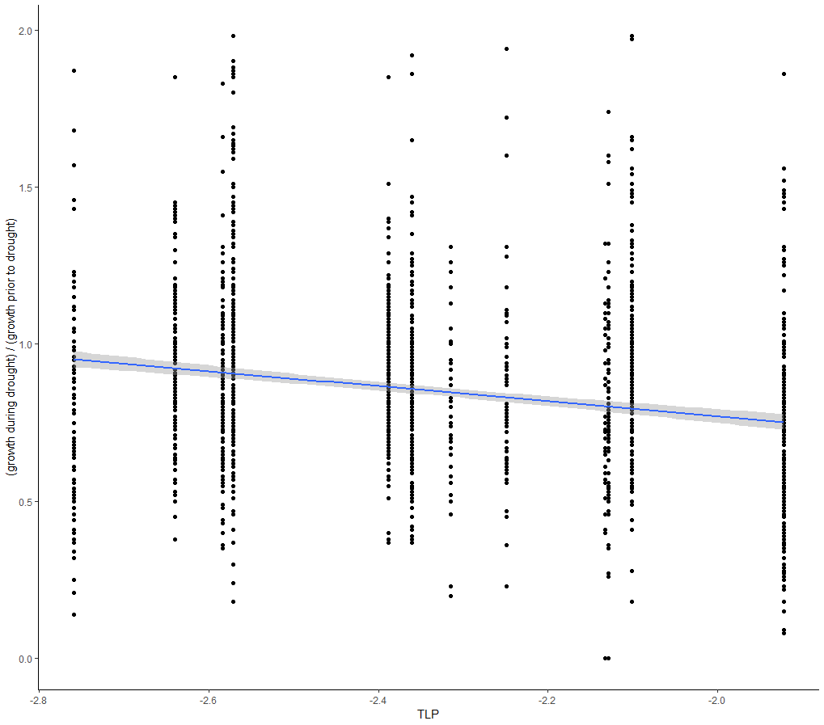
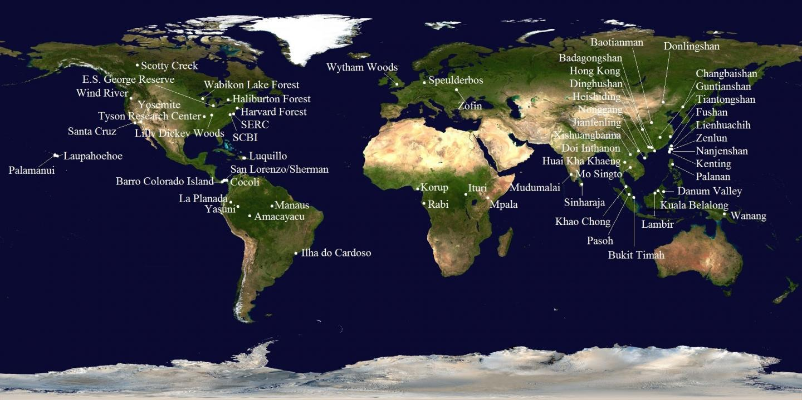
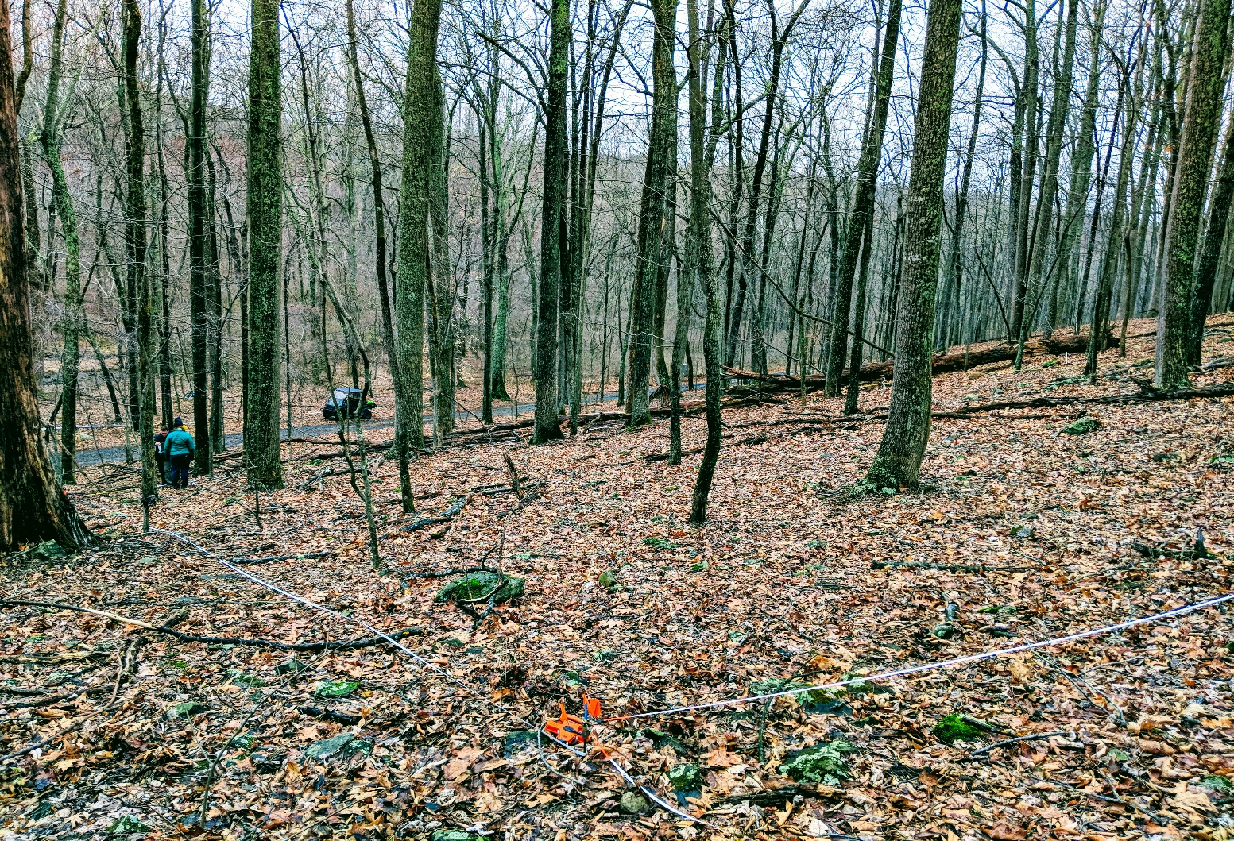
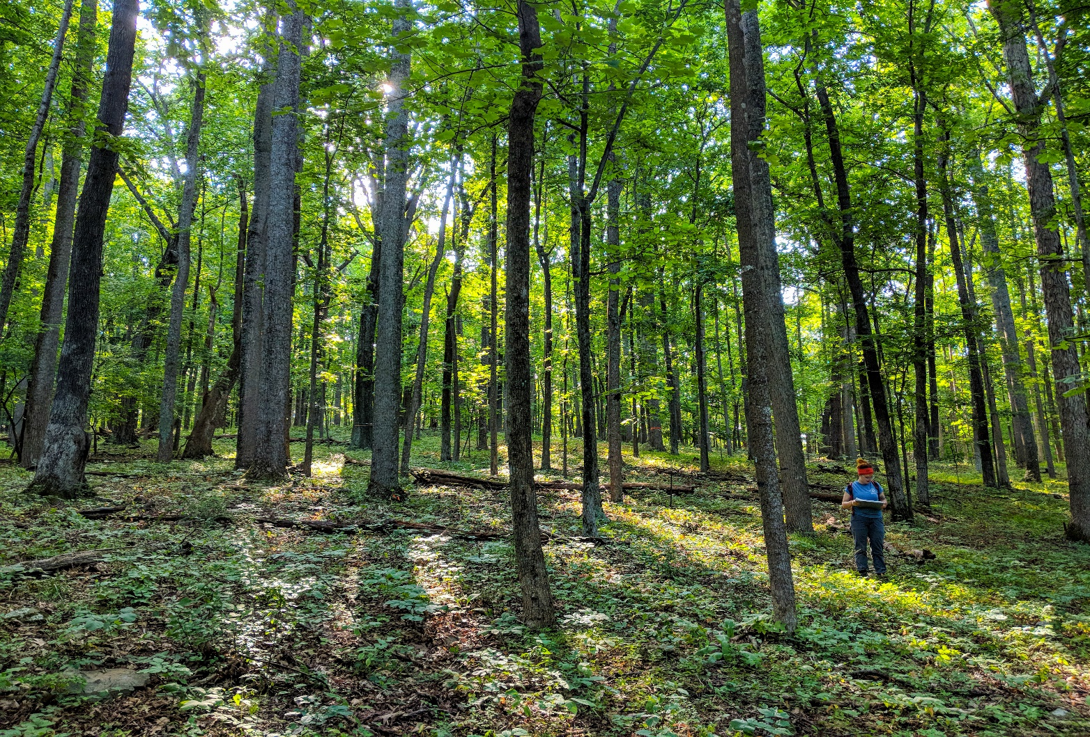
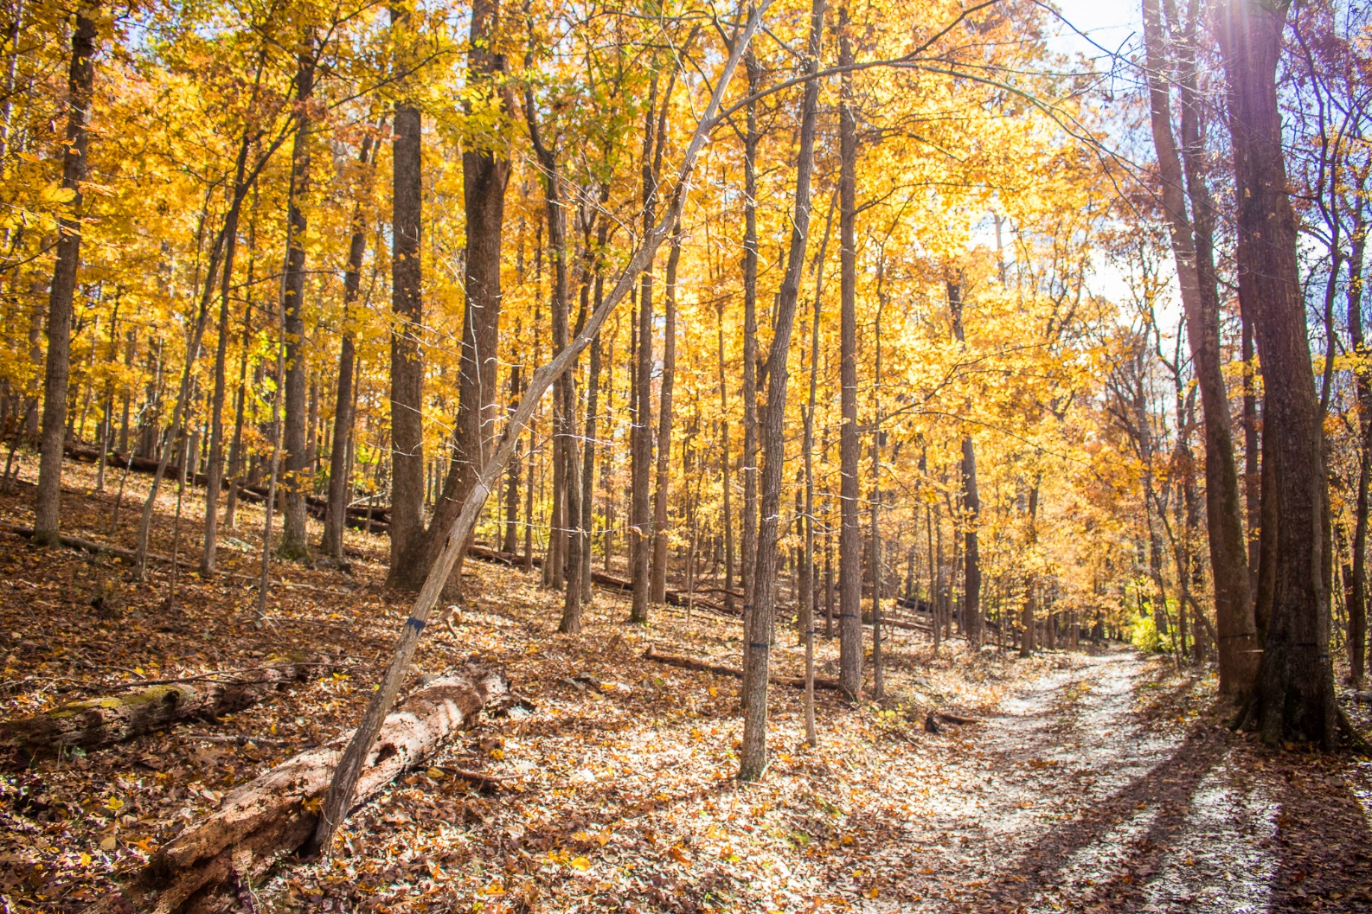
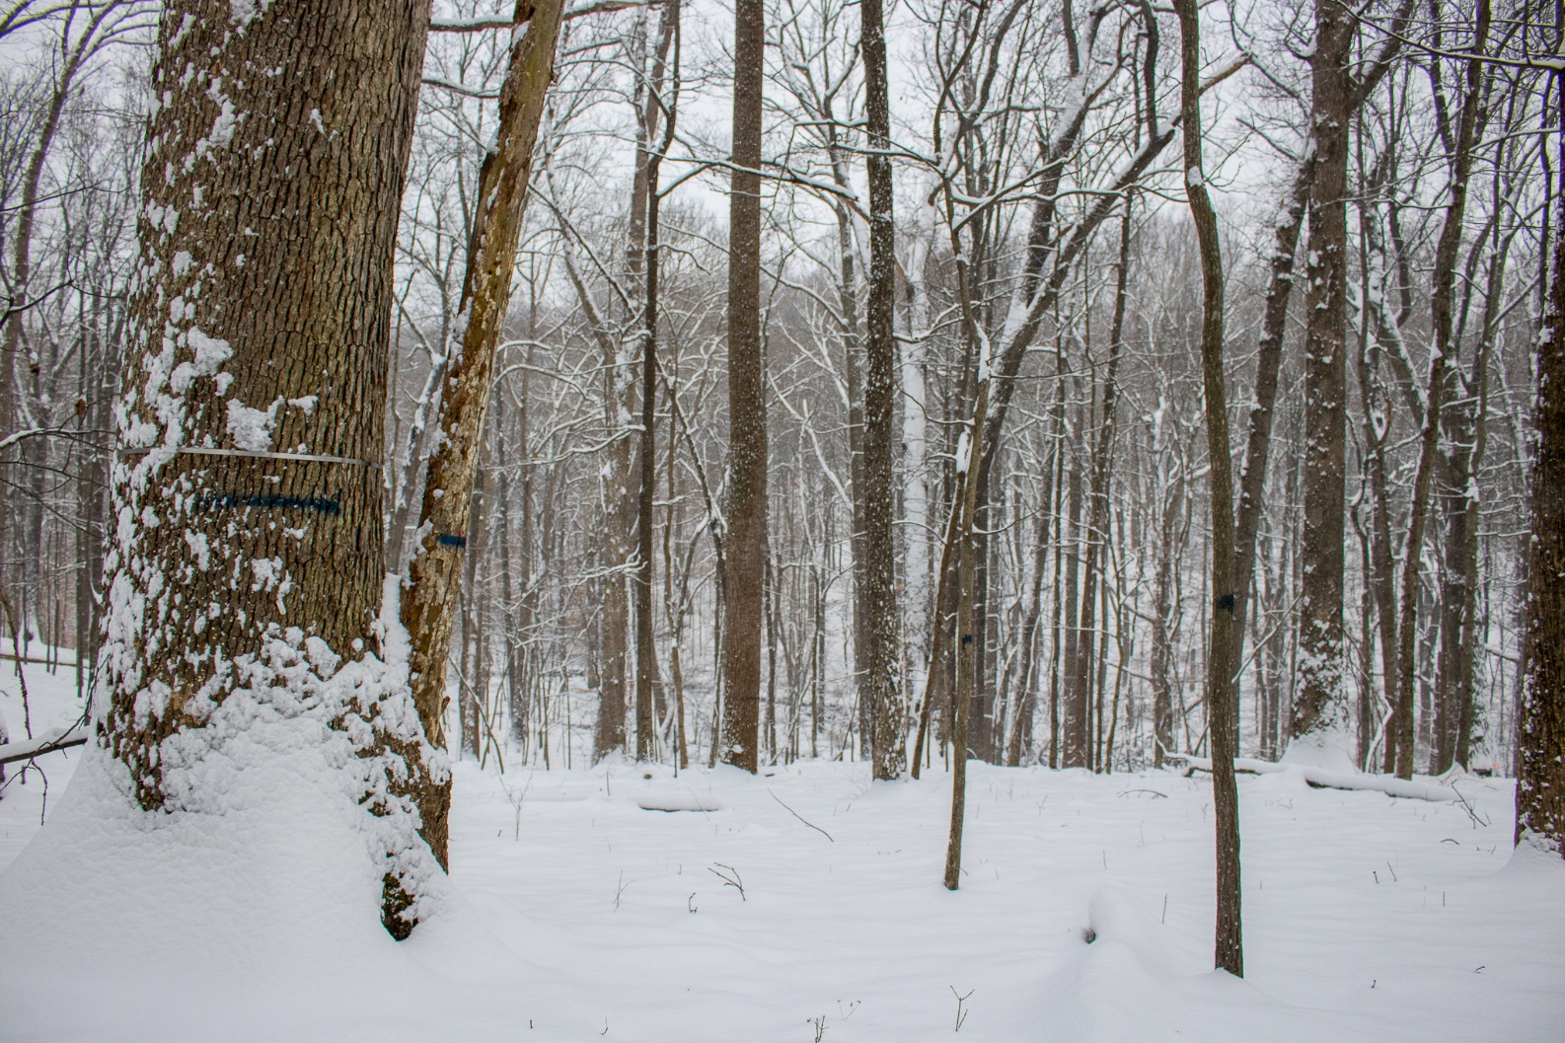
Tree Growth and Mortality
A Temperate Deciduous Forest in an Era of Global Change
Contributors: Ian McGregor (presenter), Kristina Anderson-Teixeira (PI), Ryan Helcoski, Norm Bourg, William McShea, Erika Gonzalez, Valentine Herrmann, Alan Tepley
The Forest at SCBI
Climate Change and Tree Growth
When Attackers Come to Play
Why Forests?
They support biodiversity
Sustain half of all known species
They regulate climate
Contain 45% of carbon in the terrestrial biosphere
They are threatened
Global change pressures
(including climate change, pollution, agricultural expansion, logging, non-timber forest product extraction, hunting, and the spread of invasive species) threaten biodiversity, alter community composition, and drive feedbacks to climate change
How does climatic variation affect tree growth?
We used a 111-year tree ring record for 14 species to characterize climate responses of tree growth.
Growth responded positively to cool, moist growing season conditions.
While relatively moist conditions and elevated CO₂ appear to have buffered climate sensitivity in recent decades, woody productivity of this forest is climate-sensitive
Likely to decline under projected hotter and drier growing season conditions
How do exotic forest insects and pathogens (EFIP) impact different species?
SCBI and Shenandoah National Park (SNP)
*see map in first column
EFIP have dramatically reduced abundance and biomass of eight tree taxa over the last century
Castanea, Ulmus, Juglans, Cornus, Cercis, Quercus, Tsuga, and Fraxinus
Which trees are most climate-sensitive?
Larger trees tend to suffer larger growth decreases during drought (relative to their regular growth).
This trend has been observed worldwide.
Our ongoing analyses are seeking to understand whether this is driven by tree size or by canopy exposure.
We also see a significant effect of species’ leaf turgor loss point (TLP)– i.e., the level of water stress at which a leaf wilts. Species with leaves that wilt sooner are more drought-sensitive.
Isn’t this bad for biodiversity?
Yes and no.
Local (alpha) diversity impacts are mixed, while regional (gamma) diversity shows no change.
Why? Study plots can show die-offs while all EFIP-affected species remain in the region, even if populations are not reproductively viable.
Biomass is increasing (as it is in most eastern US forests), but would have increased faster without setbacks from EFIP.
ForestGEO
Global Earth Observatory
67 forest research sites around the world
Standardized survey protocol
Monitored continuously as early as 1981
Started in 2008 at SCBI
640 x 400m, 25.6 ha
https://www.eurekalert.org/multimedia/pub/80009.php
Sources
Anderson‐Teixeira, K. J., Davies, S. J., Bennett, A. C., Gonzalez‐Akre, E. B., Muller‐Landau, H. C., Wright, S. J., … Zimmerman, J. (2015). CTFS-ForestGEO: a worldwide network monitoring forests in an era of global change. Global Change Biology, 21(2), 528–549. https://doi.org/10.1111/gcb.12712
Anderson-Teixeira, K.J., Herrmann, V., Helcoski, R., Gonzalez-Akre, E.B., Tepley, A.J., … McShea, W. (in prep) Long-term impact of exotic pests and pathogens on the forests of Virginia’s Blue Ridge Ecoregion. Target journal: Global Change Biology.
Bennett, A. C., McDowell, N. G., Allen, C. D., & Anderson-Teixeira, K. J. (2015). Larger trees suffer most during drought in forests worldwide. Nature Plants, 1(10), 15139. https://doi.org/10.1038/nplants.2015.139
Gonzalez‐Akre, E., Meakem, V., Eng, C.-Y., Tepley, A. J., Bourg, N. A., McShea, W., … Anderson‐Teixeira, K. (2016). Patterns of tree mortality in a temperate deciduous forest derived from a large forest dynamics plot. Ecosphere, 7(12), e01595. https://doi.org/10.1002/ecs2.1595
Helcoski, R., Tepley, A.J., Pederson, P., McGarvey, J.C., Meakem, V., Herrmann, V., Thompson, J.R., & Anderson-Teixeira, K.J. (in revision) Inter-annual variation in woody productivity of a temperate deciduous forest is primarily governed by growing season moisture. New Phytologist.
Lloret, F., Keeling, E. G., & Sala, A. (2011). Components of tree resilience: effects of successive low-growth episodes in old ponderosa pine forests. Oikos, 120(12), 1909–1920. https://doi.org/10.1111/j.1600-0706.2011.19372.x

